Slide 1


You Only Look Once
Unified, Real-Time Object Detection.
201611772
Ko Ji Woong
Notes:
Hello. My name is Ko Ji Woong. I will present about You Only Look Once called YOLO.
YOLO is Unified, Real-Time Object Detection

Slide 2

1
Introduction
Human
Com
Object Detection?
Instantly know
what objects are in the image,
where they are, and how they interact
Don’t Know
what objects are in the image,
where they are, and how they interact
Notes:
Then Why need Object Detection? When humans see an image, They can instantly know what objects are in the image, where they are, and how they interact. But computers can't know that. So they need Object Detection.

Slide 3
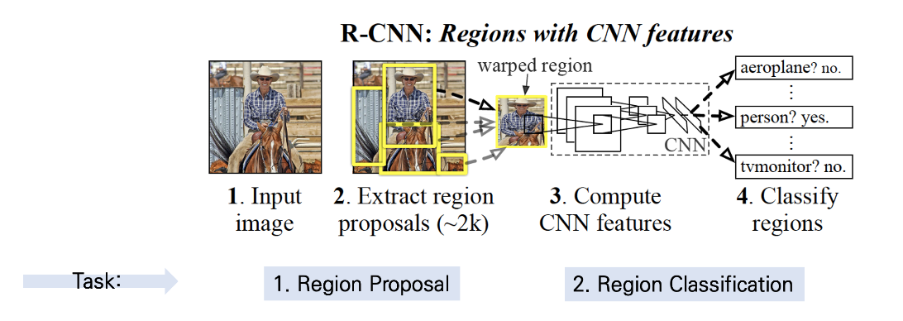
1
Introduction
R-CNN
Need 2 Stage
Region Proposal + Region Classification
Pipelines are complex, slow and hard to optimize
Notes:
One of the famous Object Detections is R-CNN. R-CNN needs 2 stage for object detection. Region proposal and Region classification. Also R-CNN’s pipelines are complex so it’s slow and hard to optimize because each individual component must be trained separately.

Slide 4
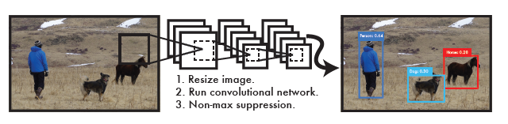
1
Introduction
YOLO
Simple
Reframe object detection as a single regression problem
Only Single Convolutional Network
Notes:
But YOLO is Simple.
YOLO reframes object detection as a single regression problem, So YOLO Only uses single convolutional network
It predicts multiple bounding boxes and class probabilities at same time

Slide 5
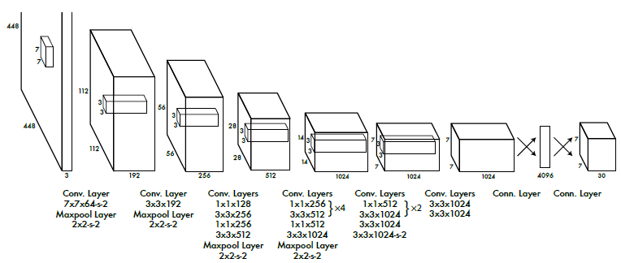
2
YOLO
Network Design
Inspired by the GoogLeNet model for image classification
24 convolutional layers followed by 2 fully connected layers
Notes:
YOLO's network architecture is inspired by the GoogLeNet model for image classification. It has 24 convolutional layers followed by 2 fully connected layers. Fast YOLO has 9 convolutional layers instead of 24

Slide 6
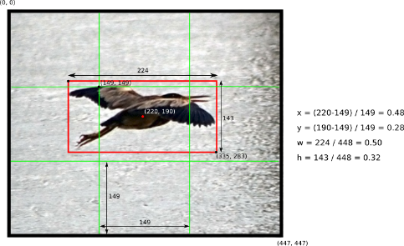
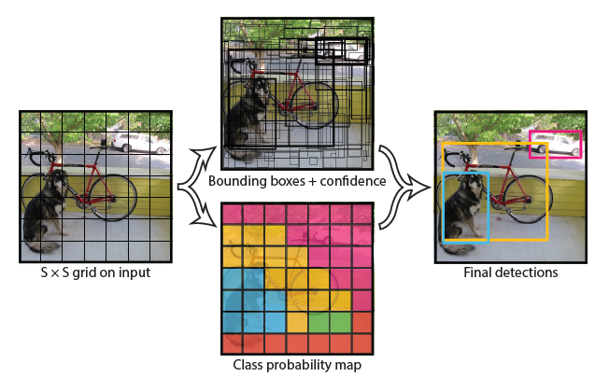
2
YOLO
How to work
Notes:
YOLO divide the input image into an S * S grid.
Each grid cell predicts bounding boxes and confidence scores for those boxes.
Each bounding box consists of x, y, w, h and confidence.
x, y are the center of the box relative to the bounds of the grid cell.
w, h are width and height predicted relative to the whole image.
confidence is the IOU between the predicted box and ground truth box.
Each grid cell also predicts conditional class probabilities.

Slide 7
Based on sum-squared error
2
YOLO
1. It weights localization error equally with classification error.
2. Posibility to lead model instability
because of confidence score of no object cells.
Loss Fuction
3. It equally weights errors in large boxes and small boxes.
Notes:
YOLO's loss function is based on sum-squared error
But there are 3 problems in sum-squared error
First. It weights localization error equally with classification error.
Second. Posibility to lead model instability because of confidence score of no object cells.
Third. It equally weights errors in large boxes and small boxes

Slide 8
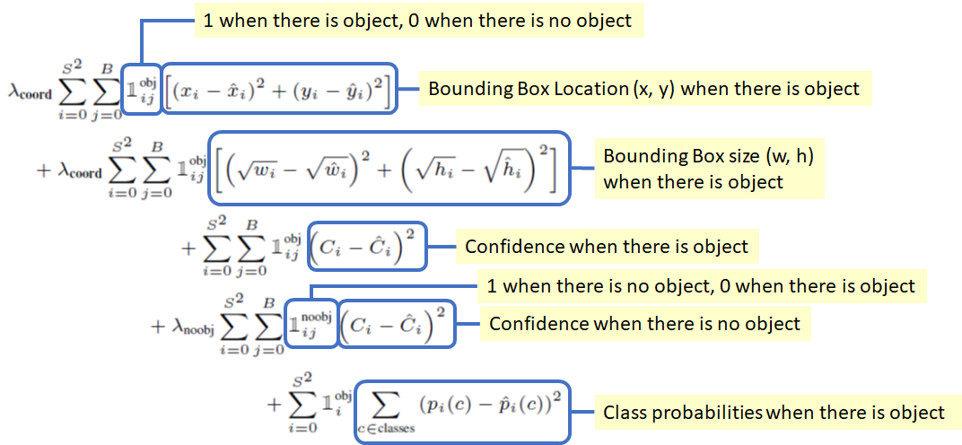
2
YOLO
Loss Fuction
Based on sum-squared error
Optimize 3 Problems
Notes:
So this Is YOLO's loss function optimizing 3 problems

Slide 9
1. Spatial Constraint
limits the number of nearby objects that our model can predict.
So YOLO struggles with small objects that appear in groups
2
2. Struggles To Generalize Objects In
New Or Unusual Aspect Ratios Or Configurations
YOLO
Because YOLO has multiple downsampling layers from the input image. So YOLO uses relatively coarse features for predicting bounding boxes.
limitation
3. Incorrect Localizations
YOLO's loss function treats errors the same in small bounding boxes versus large bounding boxes.

Slide 10
1. Extremly Fast
YOLO doesn’t need a complex pipeline
YOLO can process streaming video in real-time with less than 25 milliseconds of latency and more than twice precision of other systems
2
YOLO
2. Reasons Globally About The Image
YOLO makes less than half the number of background errors compared to Fast R-CNN Because YOLO sees the entire image during training and test
Benefit
3. Learns Generalizable Representations Of Objects
When trained on natural images and tested on artwork, YOLO outperforms top detection method .
YOLO is highly generalizable. so it is less likely to break down when applied to new domains or unexpected inputs

Slide 11
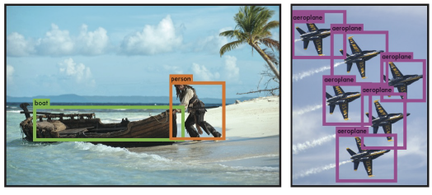
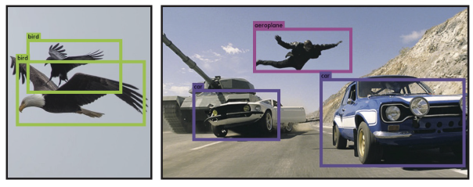
2
YOLO
Real-time
It functions like a tracking system
Notes:
YOLO is a fast, accurate object detector. so when attached to a webcam it functions like a tracking system, detecting objects as they move around and change in appearance.

Slide 12
3
YOLO
DPM
Other Fast Detectors
>
Comparison
Object Detecton
YOLO is faster or more accurate model
Notes:
DPM and Other Fast Detectors such as fast and faster R-CNN. They focus on improve the pipeline.
But YOLO throws out the pipeline entirely. YOLO is faster or more accurate model

Slide 13
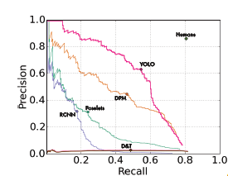
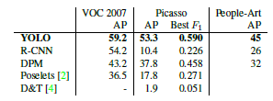
3
Comparison
ArtWork
Artwork and natural images are very different on a pixel level
But YOLO has good performance on both
Notes:
Artwork and natural images are very different on a pixel level
R-CNN has high AP. but it drops off considerably when applied to artwork.
DPM maintains AP well But it starts from a lower AP
but YOLO has good performance on Both

Slide 14
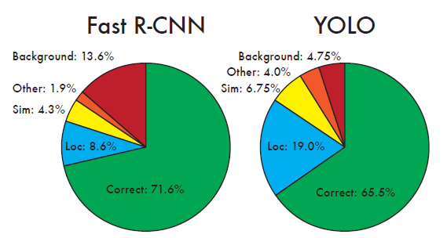
4
Combining
Error
Fast R-CNN makes much fewer localization errors
but almost 3 times more background errors.
Notes:
Comparing YOLO and Fast R-CNN, YOLO struggles to localize objects correctly and Fast R-CNN makes much fewer localization errors
but almost 3 times more background errors.

Slide 15
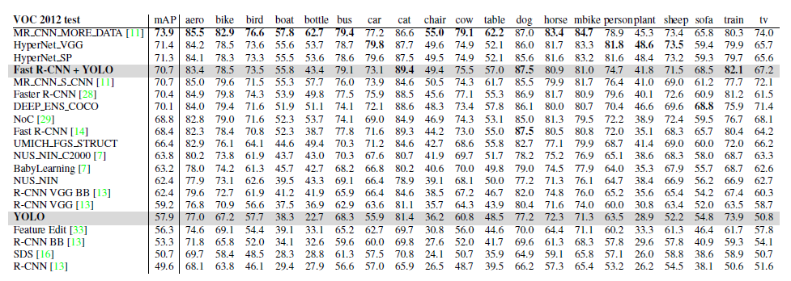
4
Combining
Fast R-CNN + YOLO
Using YOLO to eliminate background detections from Fast R-CNN get a significant boost in performance
Fast R-CNN + YOLO model is one of the highest performing detection methods.
Notes:
So By using YOLO to eliminate background detections from Fast R-CNN get a significant boost in performance.
R-CNN is here Fast R-CNN+YOLO is here
It boost 5 spots up on the leaderboard.
Fast R-CNN + YOLO model is one of the highest performing detection methods.
But this combination doesn't benefit from the speed. Because they run seperately and just combine the results.
But YOLO is so fast it doesn't add a lot of time.

Slide 16

“THANK YOU FOR WATCHING”

